Slide 1
AGRO HELP SYSTEM
Agriculture Management System
UNDER THE GUIDENCE OF
DR . FIGUL MAM

Slide 2
TEAM MEMBERS
2110030054
VAISHNAVI
2110030203
MANISRI
2110030218
NAVYA
2110030233
RISHIKA

Slide 3
Objective of the project:
The name ‘Agro help system' indicates Intelligent Agriculture.
‘Agro help system ' is a model farmer management website application.
This site helps the farmers to sell their agricultural produce online and suggests best -in-practice farming processes.
Hence, providing a wider market and helping them to not restrict themselves to the local market.
It features online shopping for fertilizers, pesticides, machinery & tools, etc.
As a whole, ‘Agro help system’ provides a concept of virtual agricultural trade to its users.

Slide 4
Modules of the project
Customer account module
Product module
Category module
Location module
Production module
Purchase request module
Purchase order module
Seller module
Labourer module
Work request module
Article and blog module
Dashboard Module

Slide 5
Project Category:
RDBMS (Relational Database Management System)
Language(s) to be used:
Design and Interface: HTML
Programming language: PHP
Scripting language: Javascript
Database: MySQL Server

Slide 6
INTRODUCTION
The main objective of developing “Agro help system” application is to help farmers by providing all kinds agriculture related information in the website. “Agro help system” is farmer management website application which helps farmers to give best-practice farming processes. It helps farmers to improve their productivity and profitability. It enables farmers to sell their products online and farmers can purchase tools and seeds directly from seller. Farmers can view labours profile and they can hire labours.

Slide 7
User classes and characteristics:
There are 4 kinds of users for the proposed system.
Administrators:
Administrators are the ones who can add or administer the categories for the products, and administers the all website information’s. Administrator has full privilege of the website.
Sellers:
Sellers are the farmers and they can sell their productions through online after the registration. After the registration the farmers can login to the system by entering login id and password.

Slide 8
User classes and characteristics:
Customer:
Customers can buy products through online. The customer can send purchase request to check the quality of the products.
Worker:
Workers can receive various work requests from multiple farmers and they can also reject or approve a request depending upon their interest.

Slide 9
Specific requirements
Software Interfaces:
Development tool: PHP : Hypertext Preprocessor, JavaScript.
Data Base server: MySQL

Slide 10
Functional Requirements:
Login module:
In this module, the customer, seller, worker and the admin can login to the system by entering login id and password. The system opens main account page after the login.
Customer module:
The customer can register to the website by entering profile details. The customer can purchase products which are uploaded by administrator. They can also send purchase request for purchasing farm produce which is uploaded by farmers. After quality test and price quotation, the customer can approve or reject the purchase request.
Seller module:
The farmers are the sellers where they can sell their productions online. The system will display farm produces in the main page of the website.

Slide 11
Functional Requirements
Worker module:
This module is for labours where they can register by entering their profile and experience details. The farmers can hire farm labourers in this module.
Dashboard module:
Dashboard module is for administrator and employees. In the dashboard module, admin has complete settings of the website. Employees can manage all kinds of records.
Article module:
In the article module, employees or admin can post news and blogs. This article module is helpful for farmers. The farmers can view the article by browsing article menu.

Slide 12
Functional Requirements:
Category module:
In this module, the administrator can create different types of categories. The system has three types of categories: i.e. Farm Produce, Agricultural Machinery & Tools, and Article types.
Location module:
This is the master page where admin can add country, state, city.
Products module:
This website sells two kinds of products. Admin or employees can sell products directly and it has another option where farmers can sell their productions online.
Billing Report:
The system generates billing after purchasing the product. The system calculates total cost automatically. In the billing report, it displays customer contact details, billing details, and purchased product information.

Slide 13
Safety Requirements:
In case the customer forget their password, they can recover the password in the Forgot Password panel
The password stores in the database in the format of encrypted password.
Security Requirements:
Only authenticated users can access this system.

Slide 14
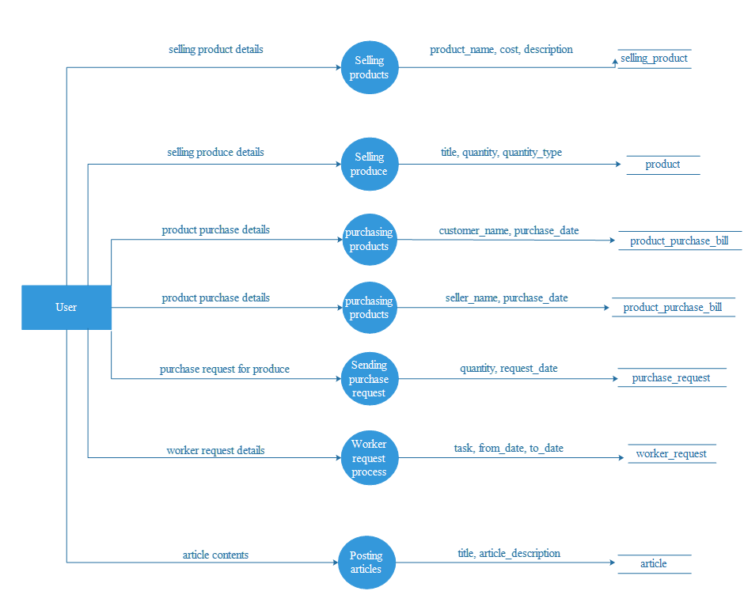
DFD

Slide 15
Modular Decomposition Of Components
Customer Component:
Structure chart for customer:

Slide 16
Worker Component:
Settings Component:

Slide 17
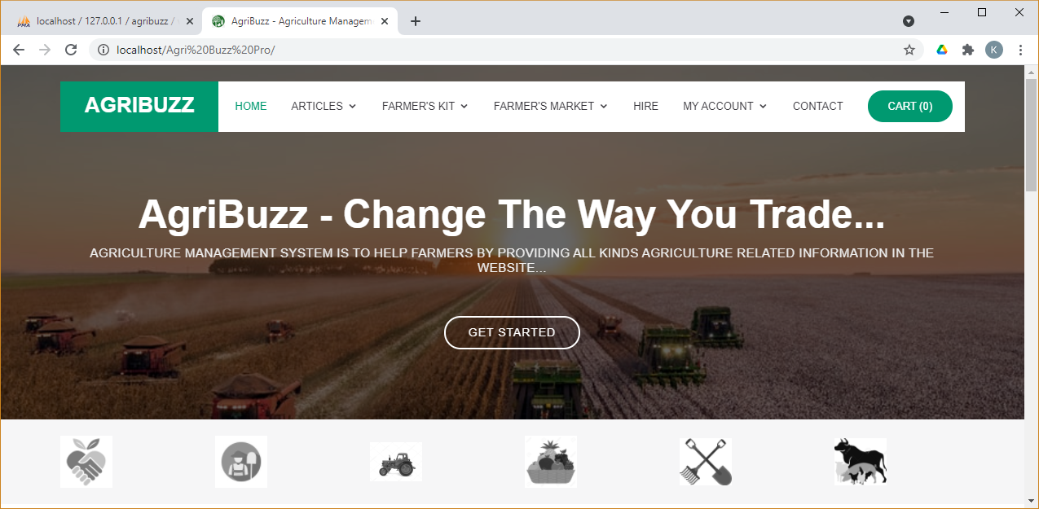

Slide 18
Limitations

Slide 19
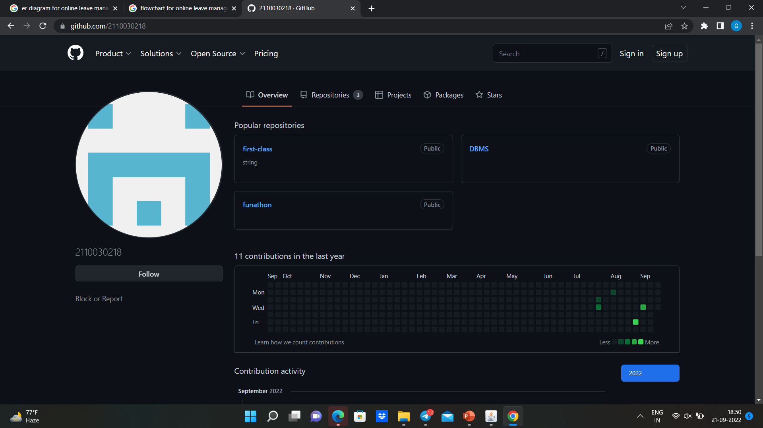
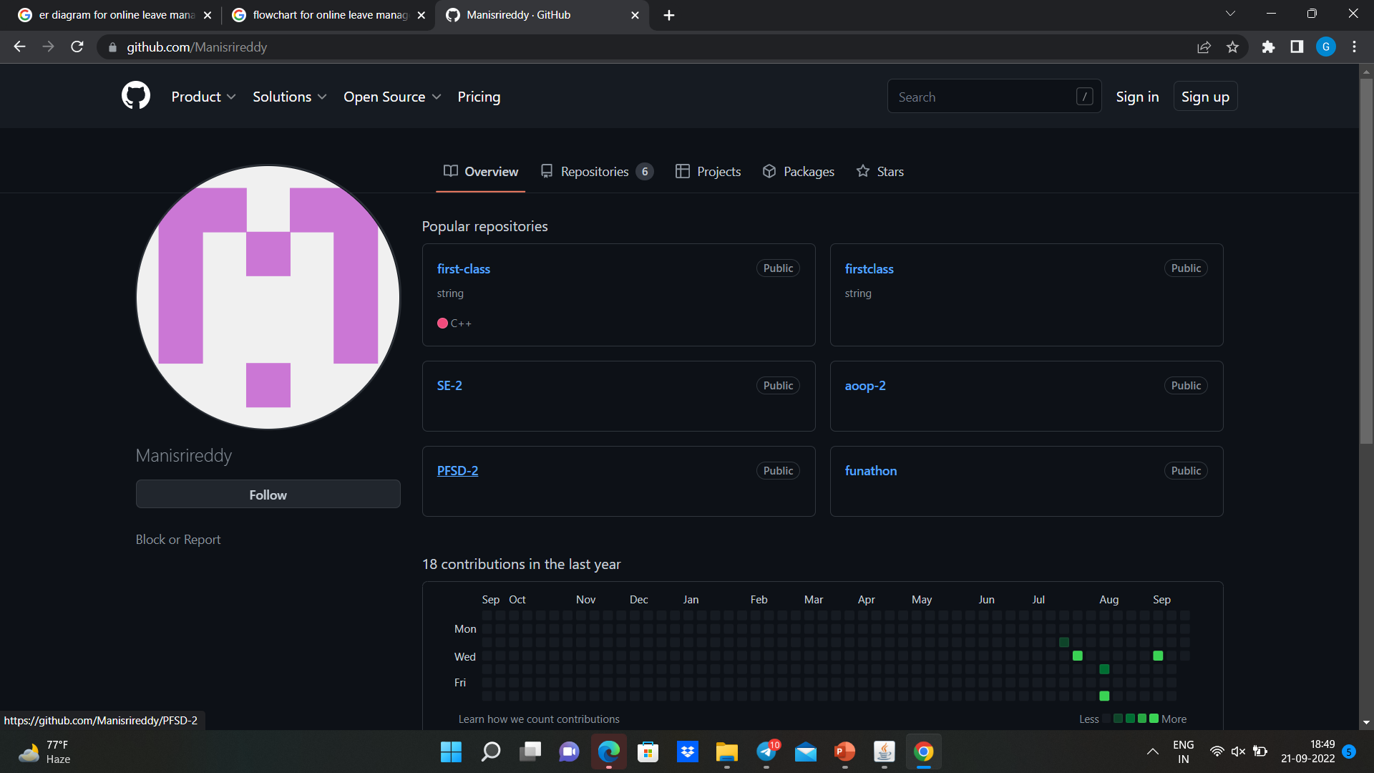
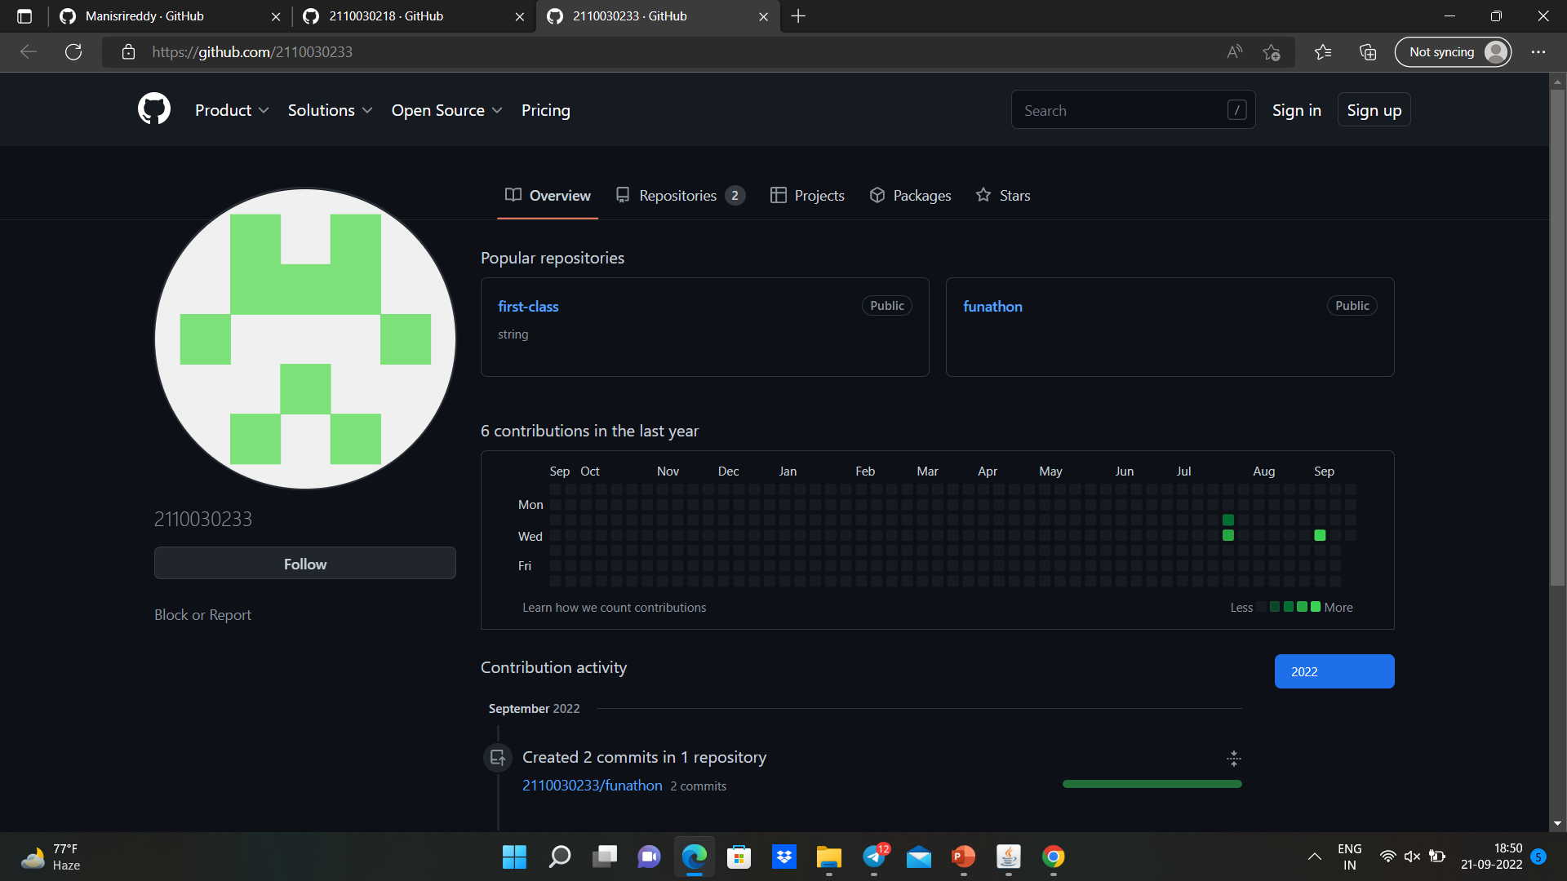
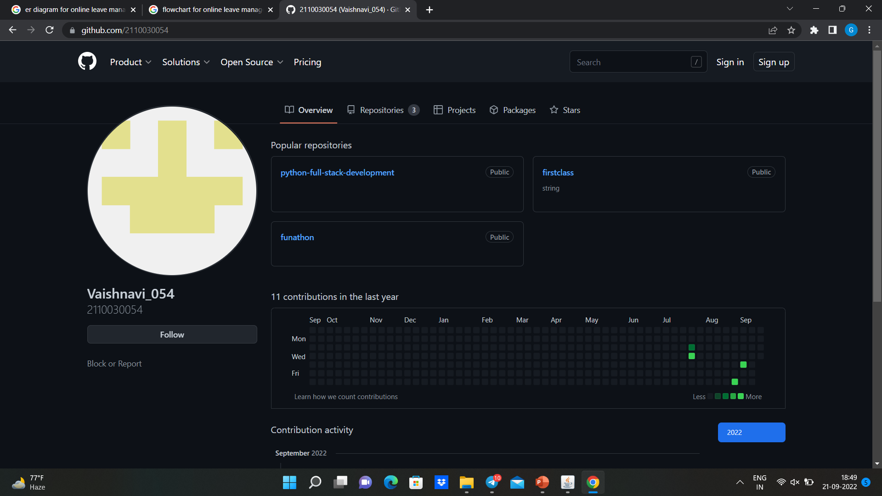
GITHUB SETUP

Slide 20
The project is web application and internet connection is required to access the website.
The administrator and seller should keep status online to check latest transactions.
The workers must be active on the website to view their work requests.

Slide 21
www.google.com
www.wikipedia.com
www.w3school.com
www.stackoverflow.com
www.highcharts.com

Slide 22
THANK YOU

